Slide 1
AI in Healthcare
Alfredo Garza
09-Jun-2025

Slide 2
What is Healthcare
Healthcare is the improvement or maintenance of health via the prevention, diagnosis, and treatment of disease, injury and physical or mental illness.
A key challenge in this field is many physicians and patients may be reluctant to start relying on AI-driven diagnostics and treatment recommendations.
Predictive analytics for disease prevention help analyze patient data to accurately predict potential health risks and recommend preventive measures .

Slide 3
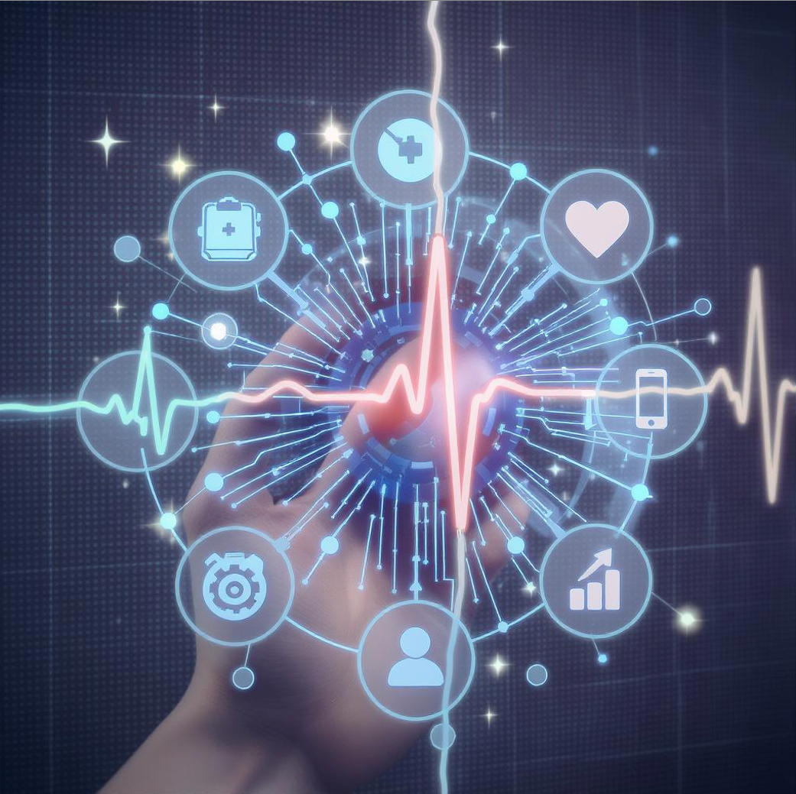
AI Use Case Motivation - Explainability
How to build trust in AI forecasts and predictive treatment recommendations
Example: Hospitals being adoption of explainable AI (XAI) to help Healthcare professionals verify AI-driven discoveries which are then relayed to patients

Slide 4
AI Techniques Used in This Domain

Slide 5
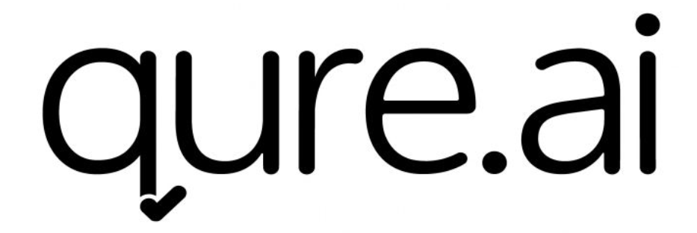
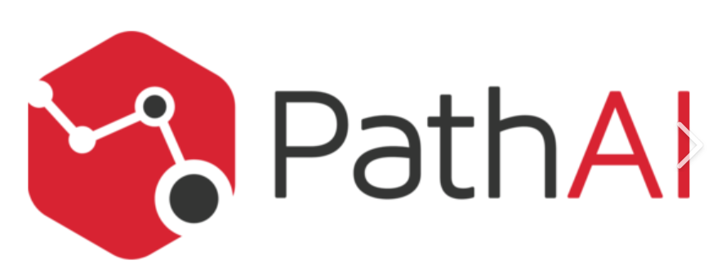

Key Applications (Case Studies)
Qure.ai – An FDA cleared solution to detect, measure and track biometrics. Products include Lung Caner Suite (detect early-stage lung cancers on chest X-rays) and Emergency Suite (detect expanding findings like Pulmonary Embolisms, brain bleeds and collapsed lungs.
PathAI – AI-powered pathology application used for drug and diagnostic development. These include quantifying cancer-causing biomarkers in patients, spatial characteristics of tumors on a microscopic scale.
Aidoc – A clinical AI solution to unify healthcare AI platforms to improve workflows and patient data accuracy. This connection of care teams across specialties and departments.
Notes:
https://www.qure.ai/us
https://www.acrobiosystems.com/L-408-PD-L1.html
https://www.aidoc.com/

Slide 6
Impact & Benefits
Add your first bullet point here
Add your second bullet point here
Add your third bullet point here

Slide 7
Challenges & Risks
Add your first bullet point here
Add your second bullet point here
Add your third bullet point here

Slide 8
Future Directions

Slide 9
Conclusion

Slide 10
Demo ??

Slide 12
Add a Slide Title - 4

Slide 13
Add a Slide Title - 5

